Slide 1

Spliceome dynamics during osteogenesis
Part 2a: Consequences of alternative splicing at the gene level (RNA-Seq)
Angel Liang
7/4/2020

Slide 2
Specificity of AS targets - multifaceted
1. Does AS regulate certain pathways? |  | Strategy: KEGG/reactome pathway enrichment
2. Does AS regulate certain protein families/domains? |  | Strategy: PFAM enrichment
3. Are only certain proteins spliced? |  | Currently looking at (in decreasing order of urgency): phenotypic targets e.g. lysosome, ER stress, Ca²⁺/H⁺ transporters, mechanosensitive ion channels | kinases, spliceosome components, transcription factors + co-regulators histone modifiers/chromatin remodelers
4. Does AS regulate upstream SFs themselves? |  | Strategy: clustering
4. Which portions of transcripts are regulated? |  | protein coding? Non-coding?... CDS, 5' UTR, 3' UTR?… induces NMD?... protein domains, Low Complexity Regions, Intrinsically disordered regions, phosphosites?...

Slide 3
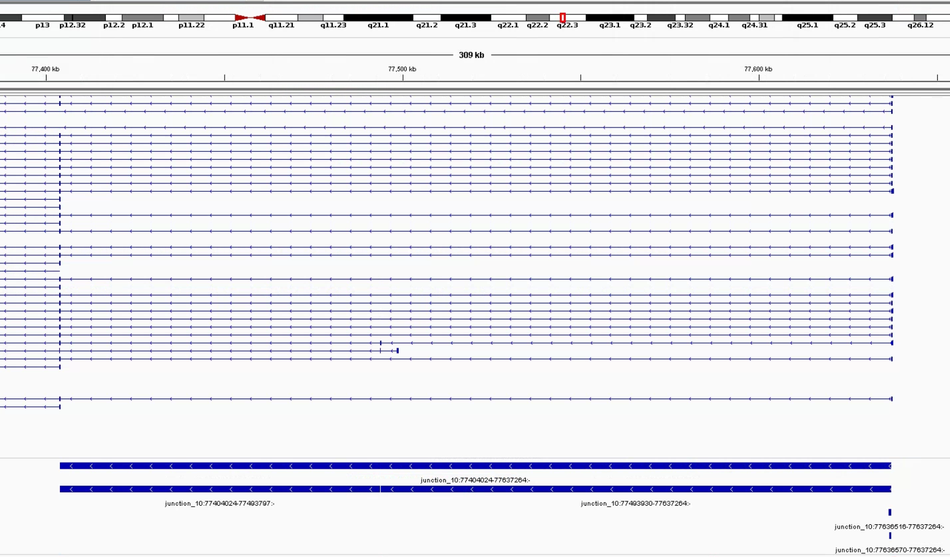
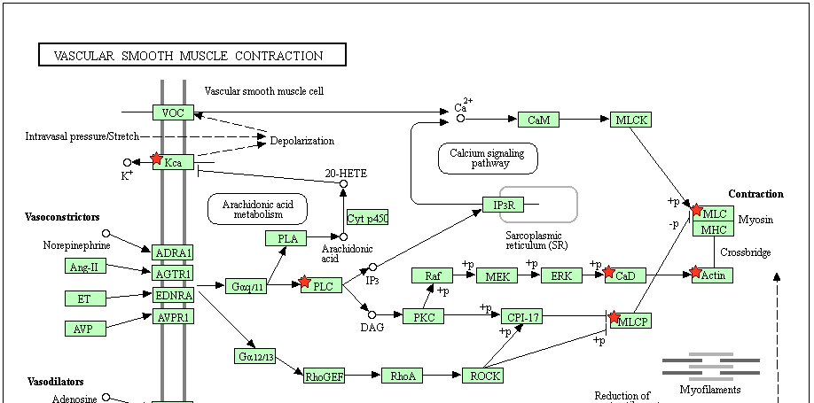
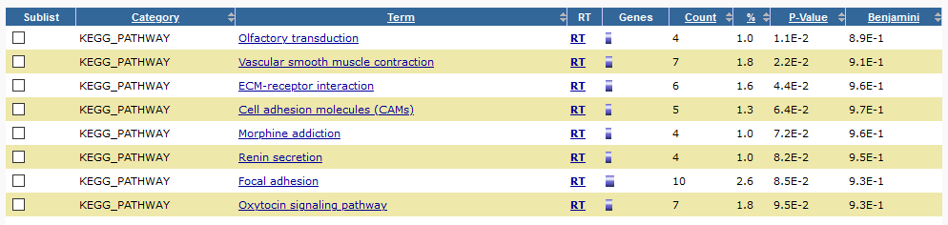
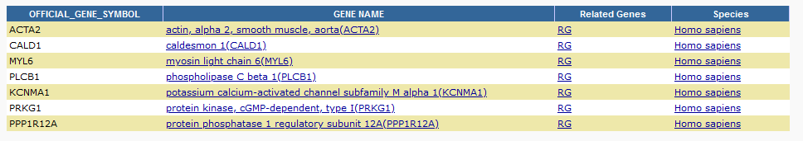
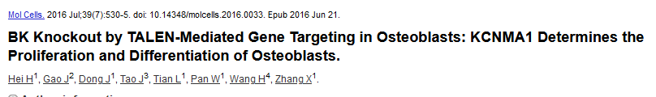
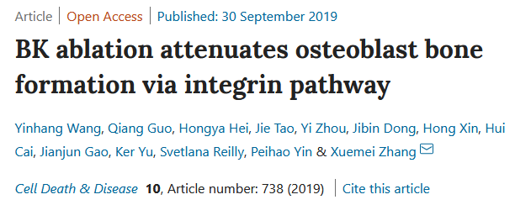
A first look at the data: JUM
398 genes with AS between first/last (12d) timepoints
KEGG pathways enriched:
Kinetics of KCNMA1 channels are determined by [intracellular calcium status,] alternative splicing, phosphorylation status and its combination with modulating beta subunits. (Genetics Home Reference, NIH)

Slide 4
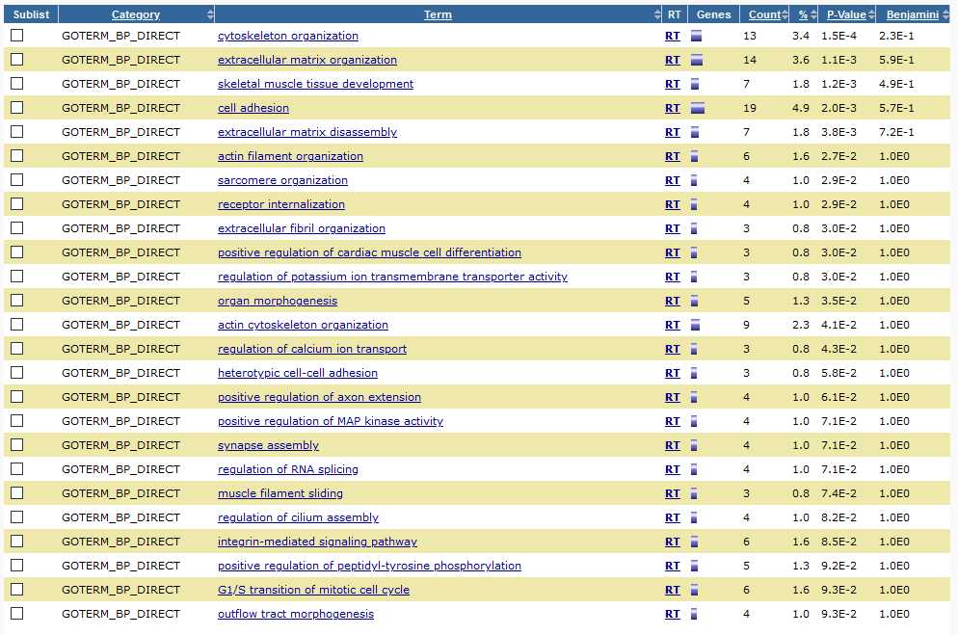
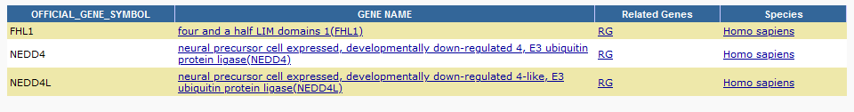
A first look at the data: JUM
398 genes with AS between first/last (12d) timepoints
BP GO term:

Slide 5
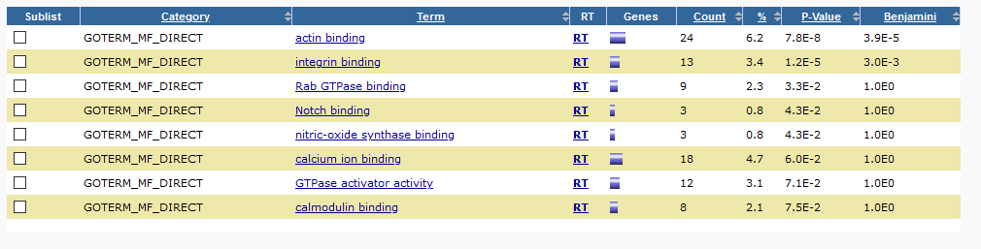
A first look at the data: JUM
398 genes with AS between first/last (12d) timepoints
MF GO term:

Slide 6
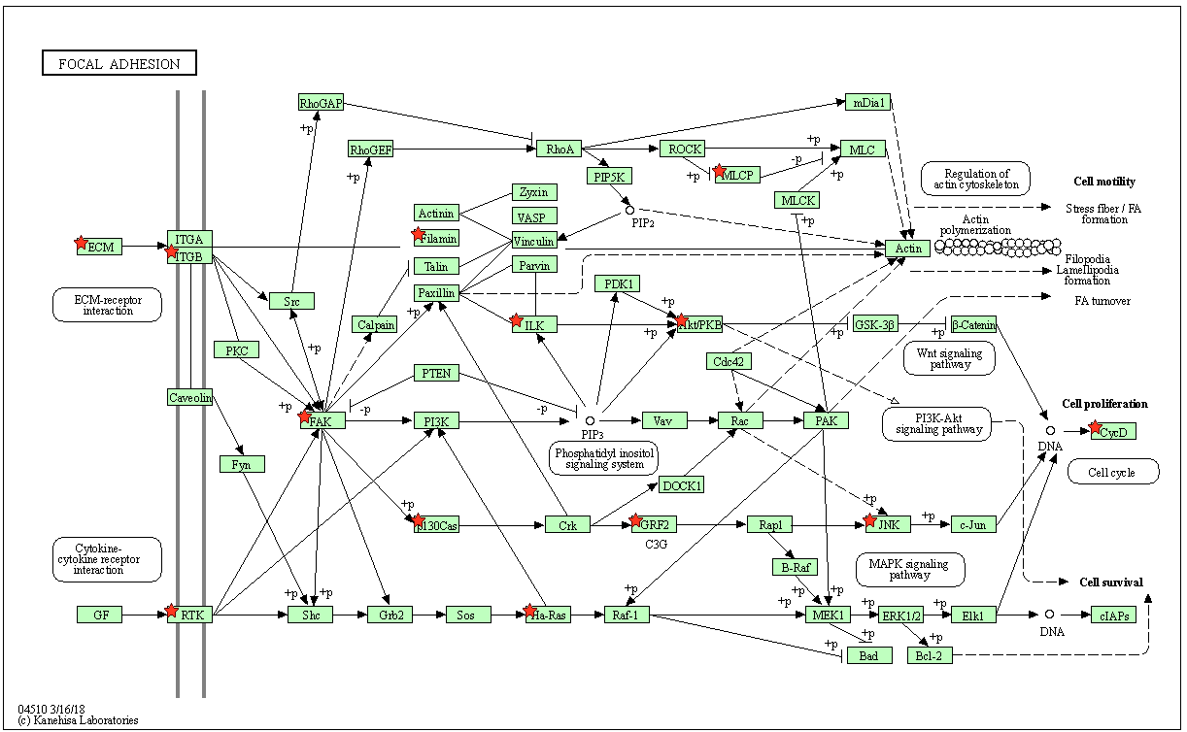
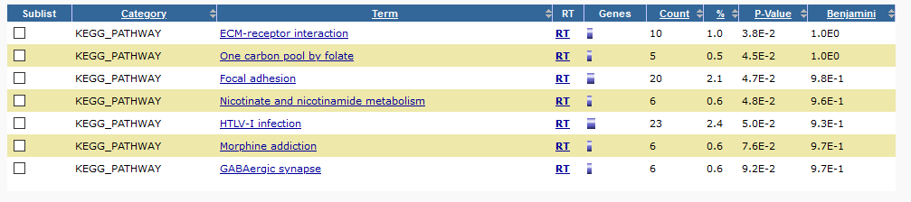
A first look at the data: JUM
983 genes with differential AS (any significant pairwise change)
KEGG pathways:
Focal adhesion/cytoskeletal components clearly important
Deep connections with mechanosensing machinery, regulated by AS.
AS seems to often occur in kinases

Slide 7
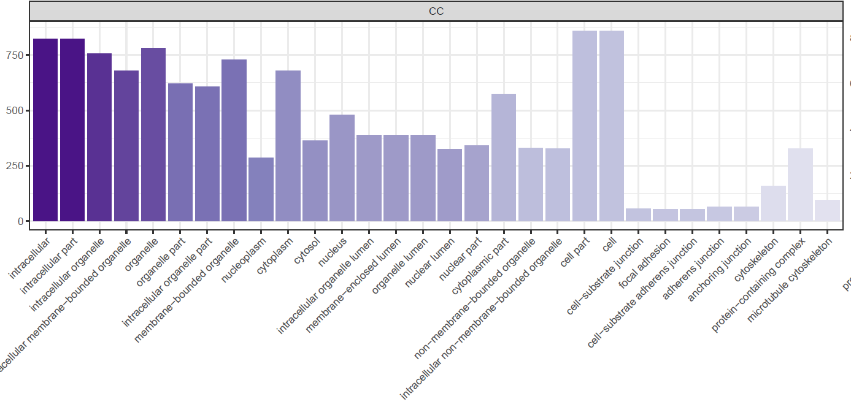
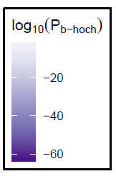
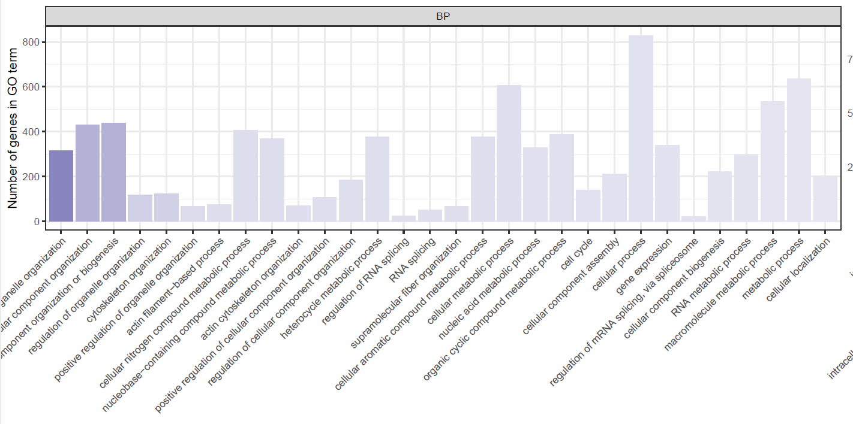
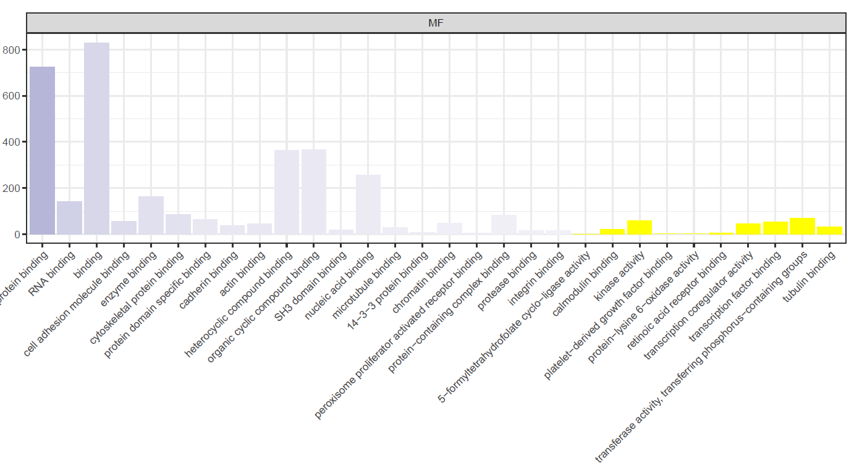
A first look at the data: JUM
Top 30 GO Term enrichment for all 983 genes differentially spliced

Slide 8
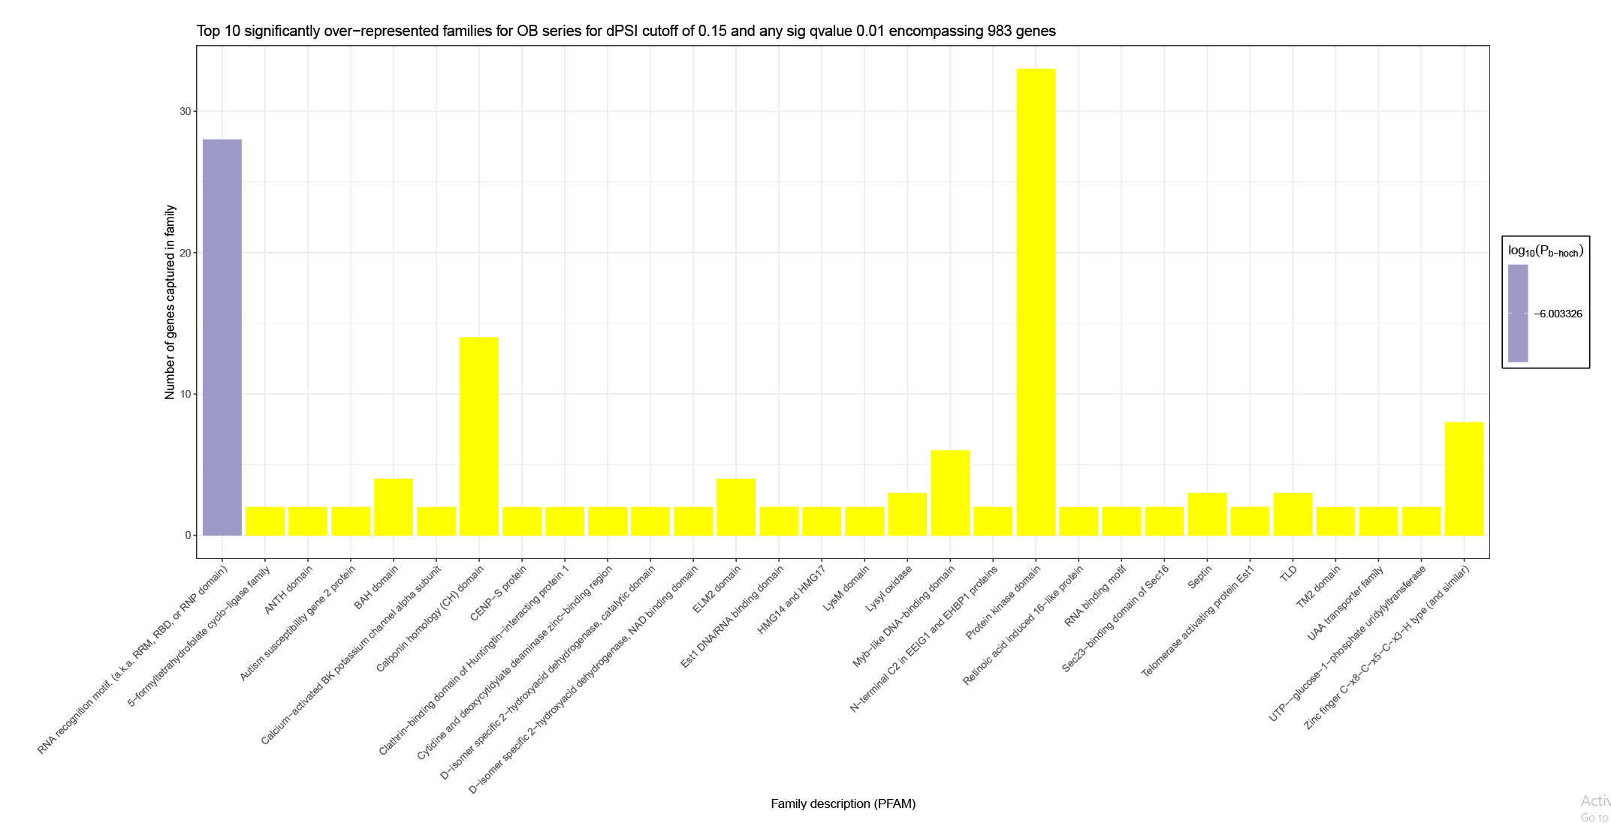
A first look at the data: JUM
Top 30 PFAM family enrichment for all 983 genes differentially spliced

Slide 9
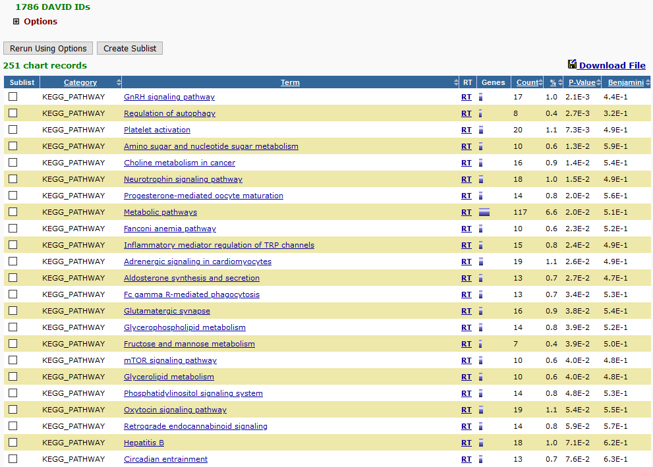
A first look at the data: PSI-Sigma
253 genes with AS between first and last time point – results too sparse to interpret
1899 genes with any differential exon were enriched
OB-specific KEGG pathways were not highly enriched
However, can observe distinct groups/families of genes:
Inflammatory mediator… TRP channels: ADCY3/4/7
Phosphatidylinositol signaling system: DGKA/E/H/Z, PLCB1/B4/D4/G1
MAPK signalling: MAPK7/8/12/13, MAP2K4, MAP3K3/6/12
Wnt: mostly transcription factors TCF7/7L2, NFATC1/3/4

Slide 10
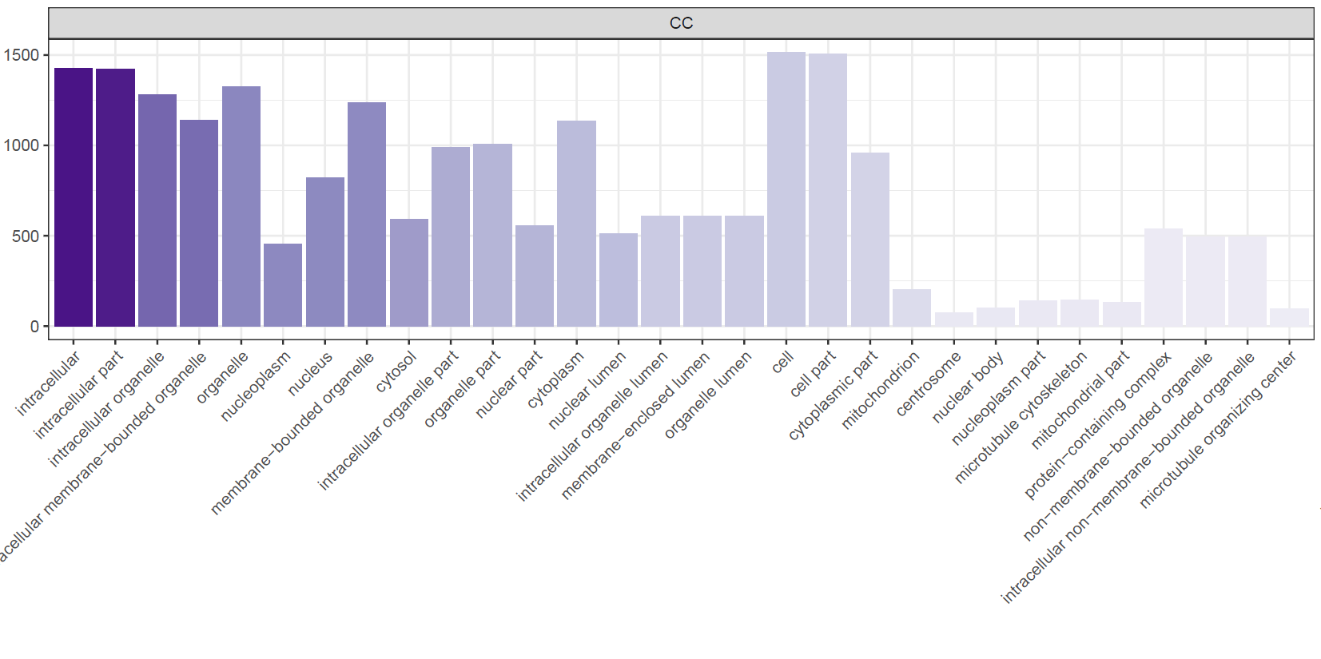
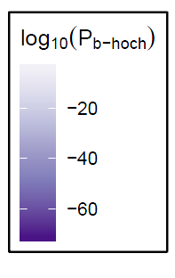
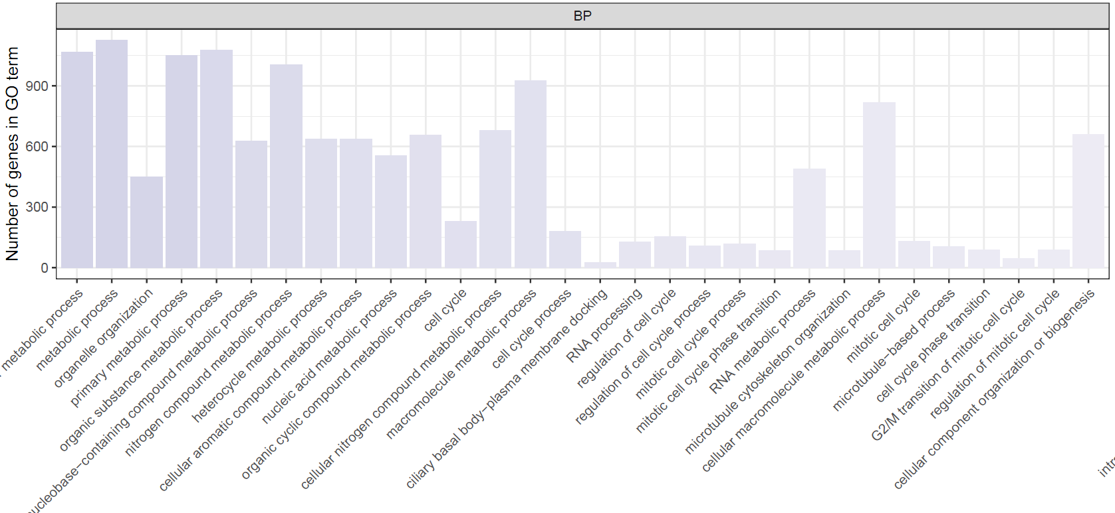
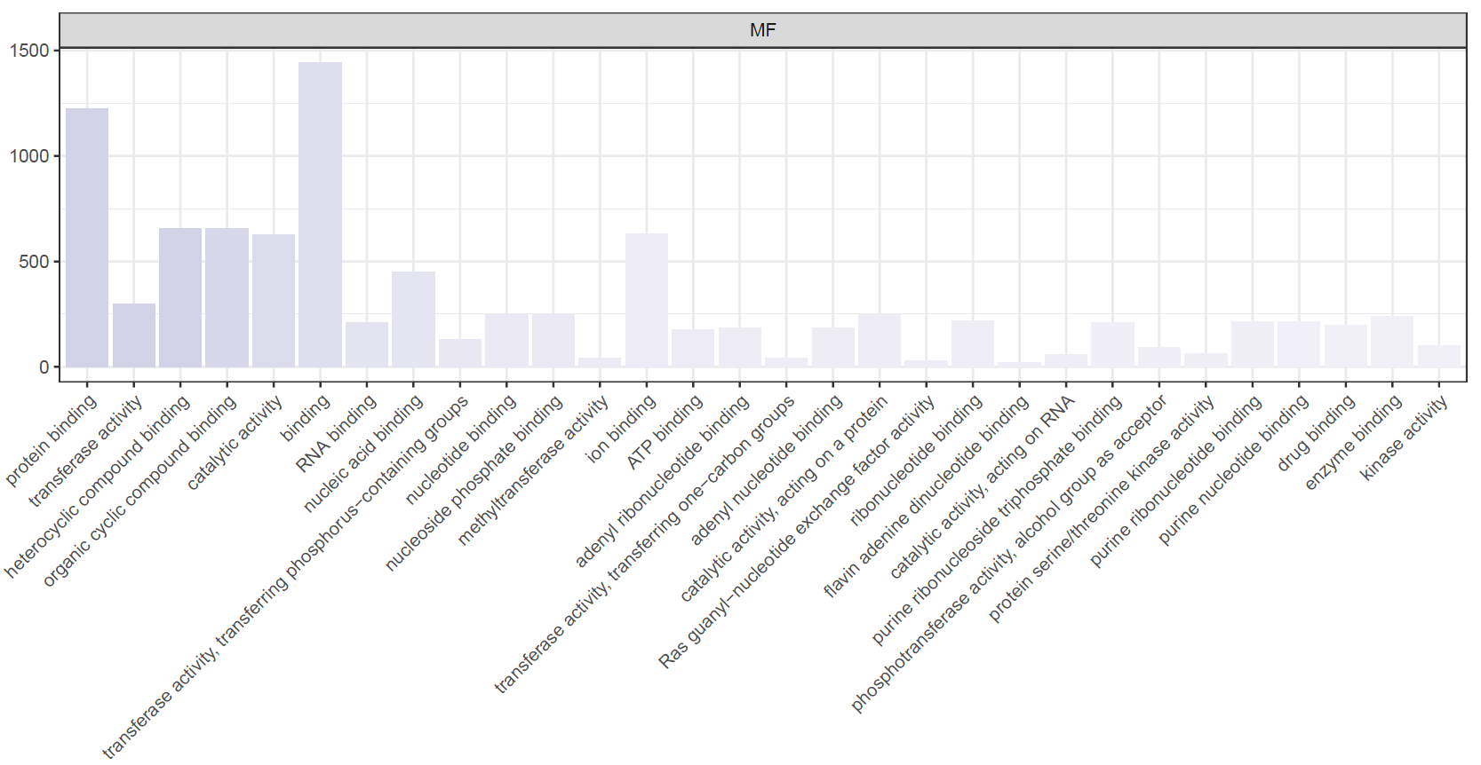
A first look at the data: PSI-Sigma
Top 30 GO Term enrichment for all 1899 genes differentially spliced
Generally, the highest enriched GO Terms are not the same as JUM
91
48
180

Slide 11
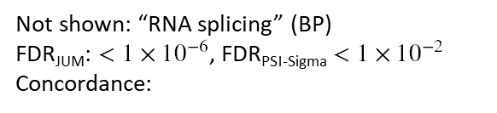
A first look at the data: PSI-Sigma
Top 30 GO Term enrichment for all 1899 genes differentially spliced
Not shown: “RNA splicing” (BP)
FDR_{JUM}: $<1×{10}^{−6}$, FDR_{PSI-Sigma} $<1×{10}^{−2}$
Concordance:
29
22
43

Slide 12
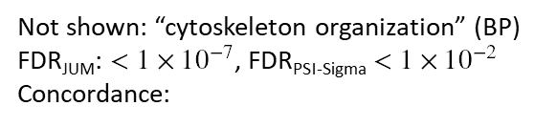
A first look at the data: PSI-Sigma
Top 30 GO Term enrichment for all 1899 genes differentially spliced
Not shown: “cytoskeleton organization” (BP)
FDR_{JUM}: $<1×{10}^{−7}$, FDR_{PSI-Sigma} $<1×{10}^{−2}$
Concordance:
73
49
110

Slide 13
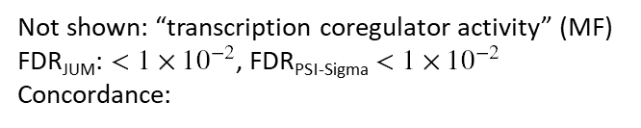
A first look at the data: PSI-Sigma
Top 30 GO Term enrichment for all 1899 genes differentially spliced
Not shown: “transcription coregulator activity” (MF)
FDR_{JUM}: $<1×{10}^{−2}$, FDR_{PSI-Sigma} $<1×{10}^{−2}$
Concordance:
28
18
54

Slide 14
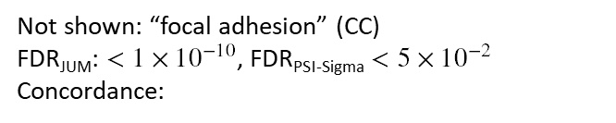
A first look at the data: PSI-Sigma
Top 30 GO Term enrichment for all 1899 genes differentially spliced
Not shown: “focal adhesion” (CC)
FDR_{JUM}: $<1×{10}^{−10}$, FDR_{PSI-Sigma} $<5×{10}^{−2}$
Concordance:
36
17
29

Slide 15
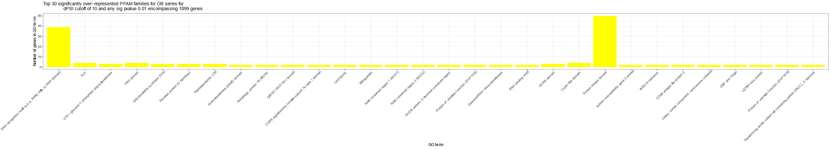
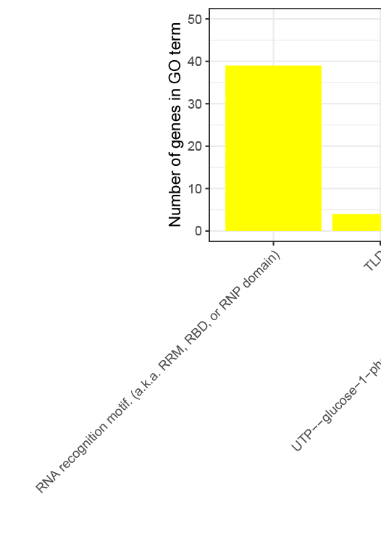
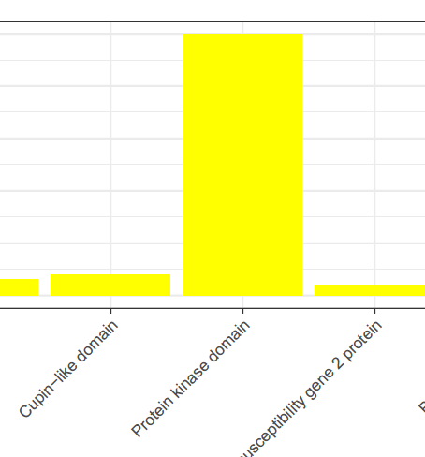
A first look at the data: PSI-Sigma
Top 30 PFAM family enrichment for all 1899 genes differentially spliced
Common:
HNRNPA2B1, HNRNPDL, HNRNPH1,
SRSF2 , SRSF3, SRSF6, SRSF11,
RBM42, PPIE, LARP7, ZNF638, SSB, ZRSR2, SNRNP70, EIF4H, RBM26
12
16
23
18
15
34
Common: MAPK8, MINK1, MAST3, PRKCE, CSNK1G3, MOK, SPEG, RPS6KB1, LIMK2, DMPK, WNK1, MAST2, SCYL2, CHEK1, MAP3K3

Slide 16
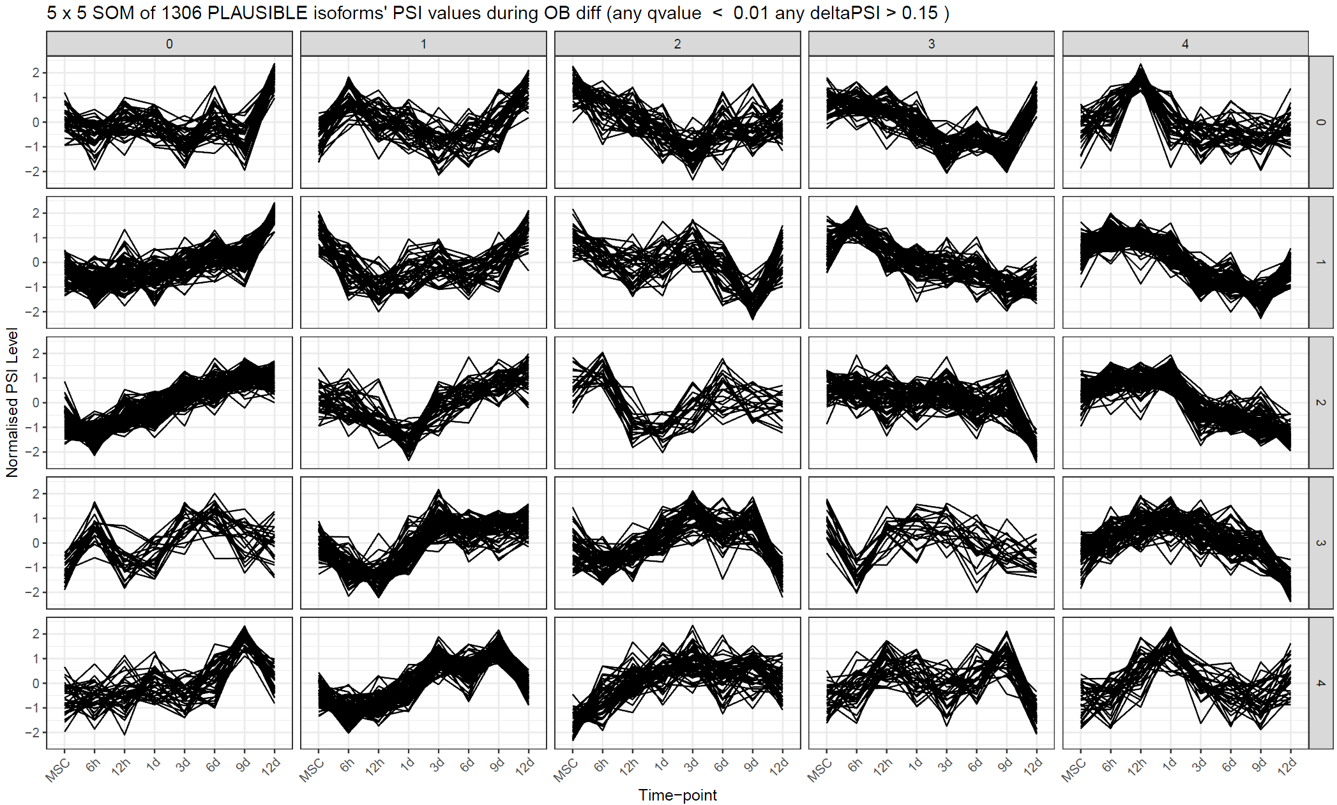
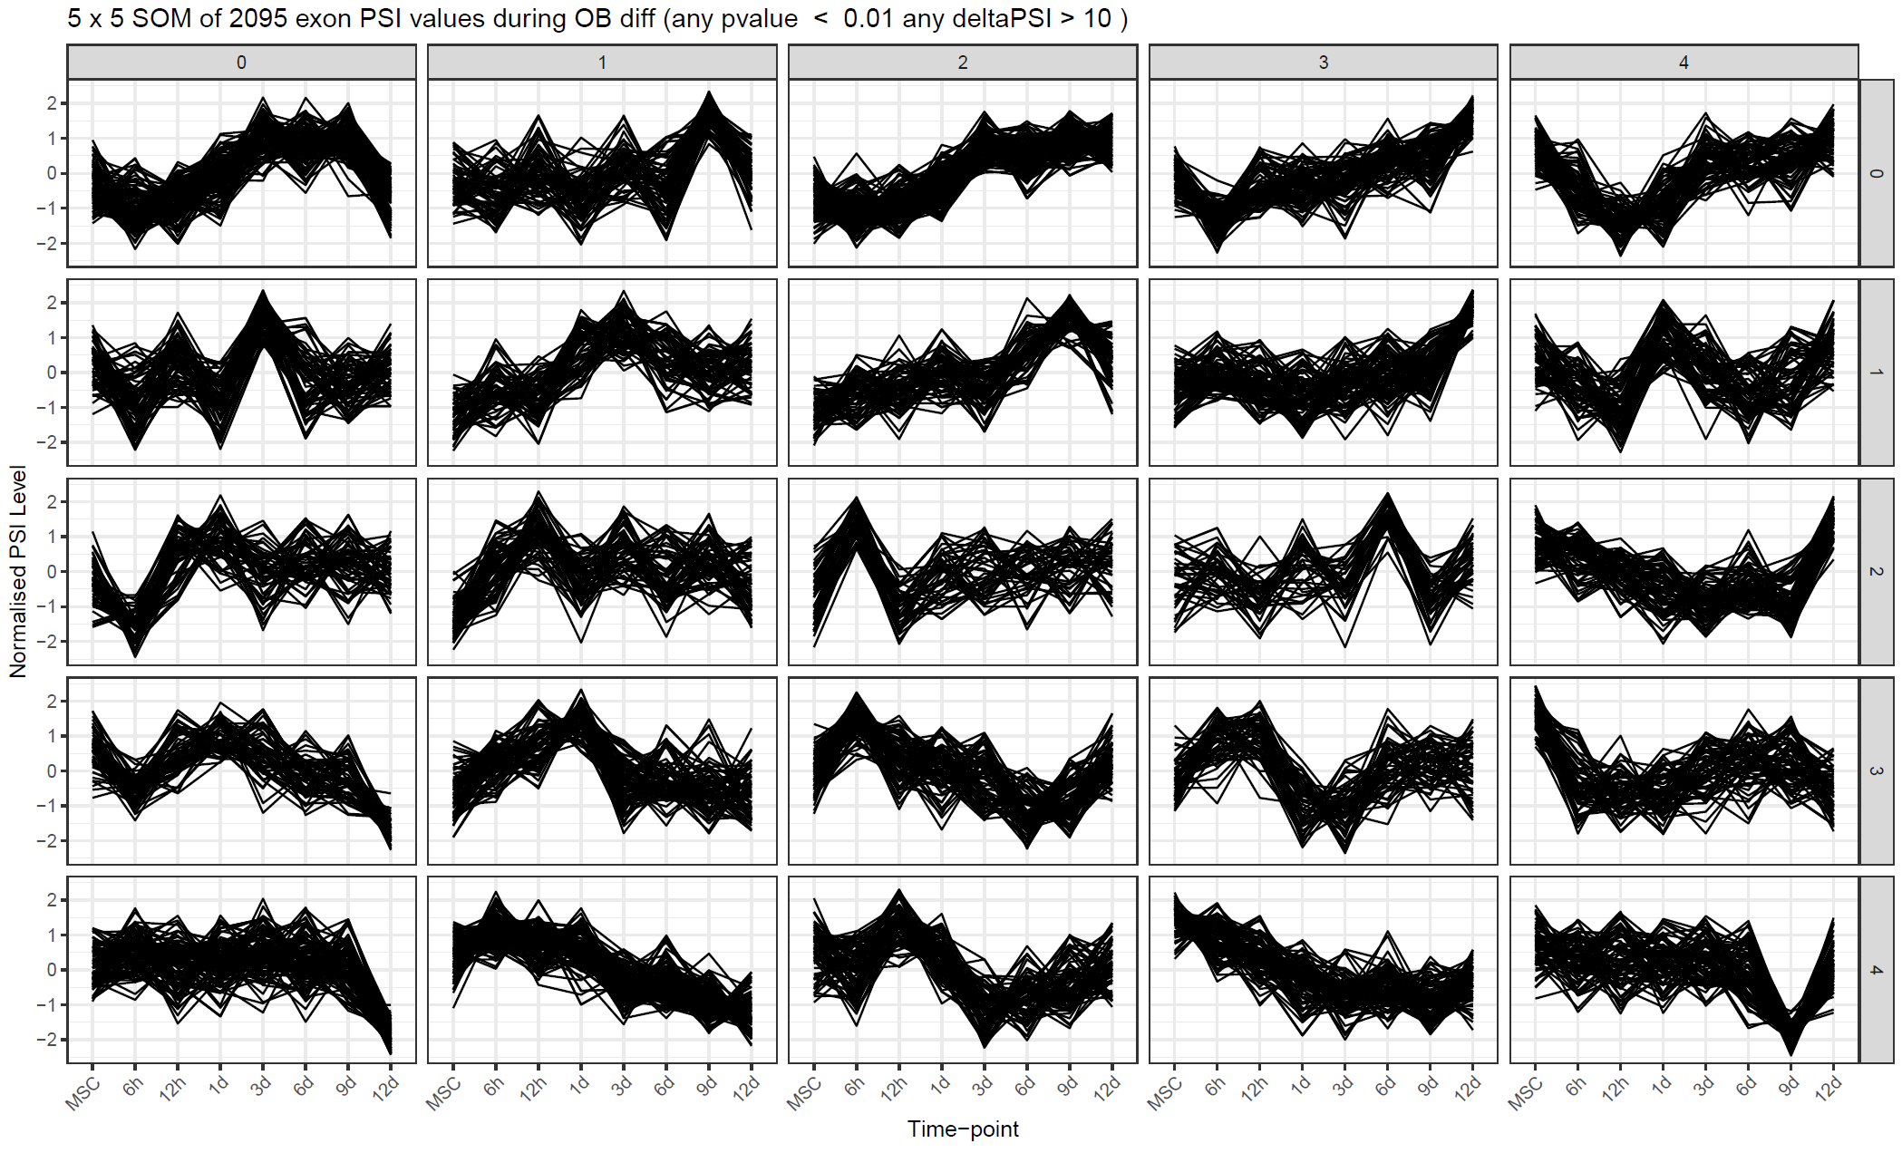
Clustering of time-series spliceomic data
Kohonen SOM
Map dimensions set to 5x5 at this point
JUM:
Differential junctions (all)
Differential junctions (plausible only)
PSI-Sigma:
Differential LSVs
Differential exons (sum of all LSVs)

Slide 17
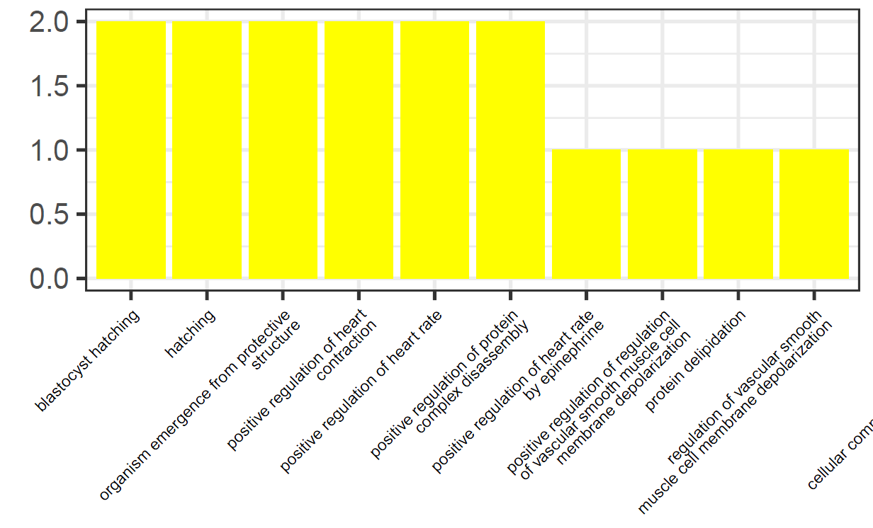
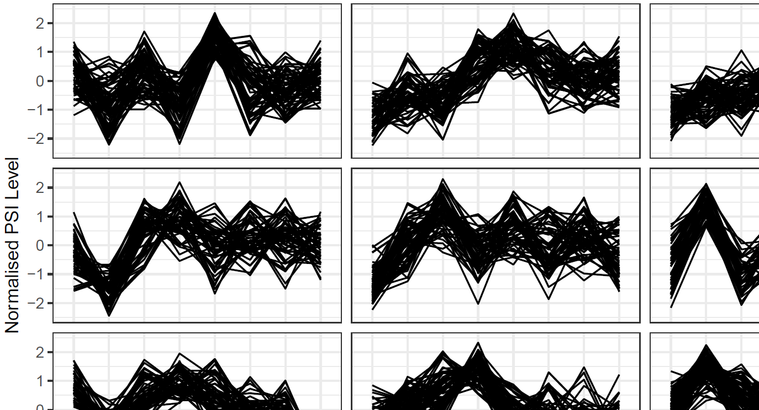
Functional enrichment (cluster-wise)
GO Terms and PFAM families for ALL genes containing differential junctions/exons
For clustered junctions/exons, functional enrichment done:
GO Terms (each cluster)
PFAM families (each cluster)
Upstream RNA-binding proteins (from CLiP-Seq, FLASH-Seq)
JUM: plausible junctions
PSI-Sigma: sum exons

Slide 18
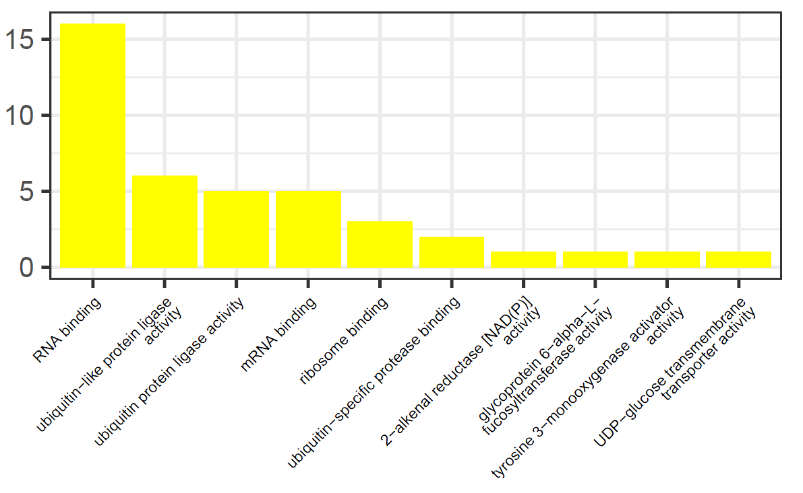
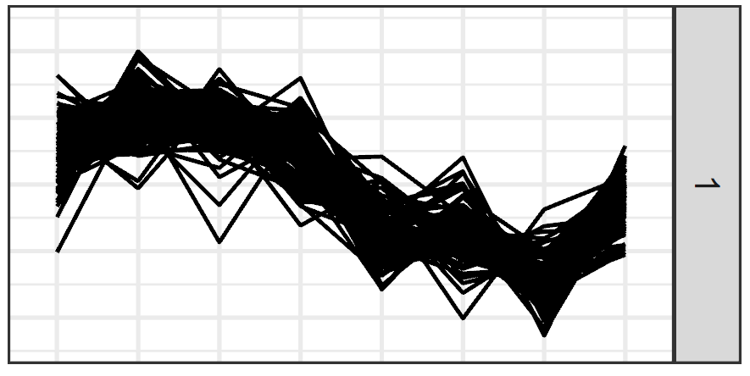
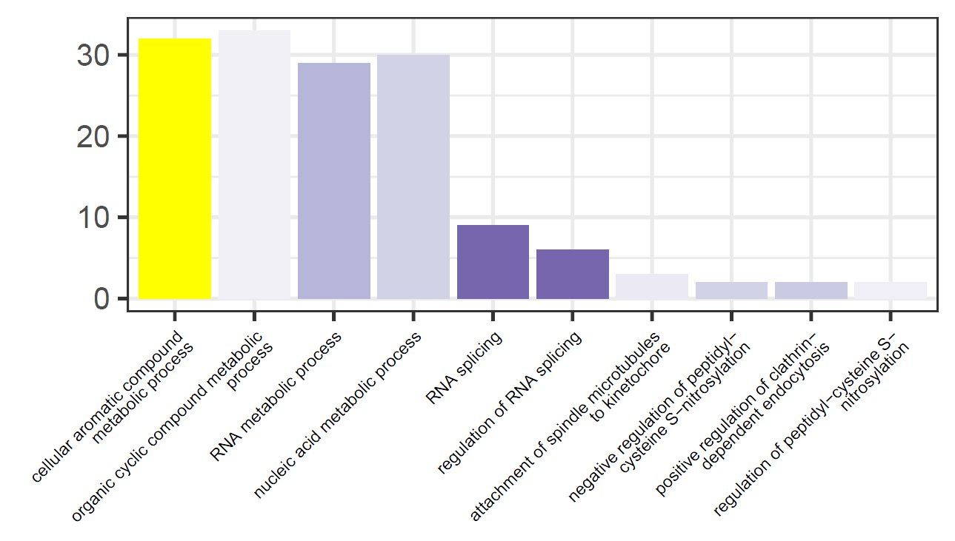
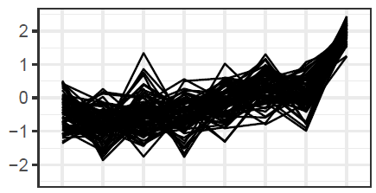
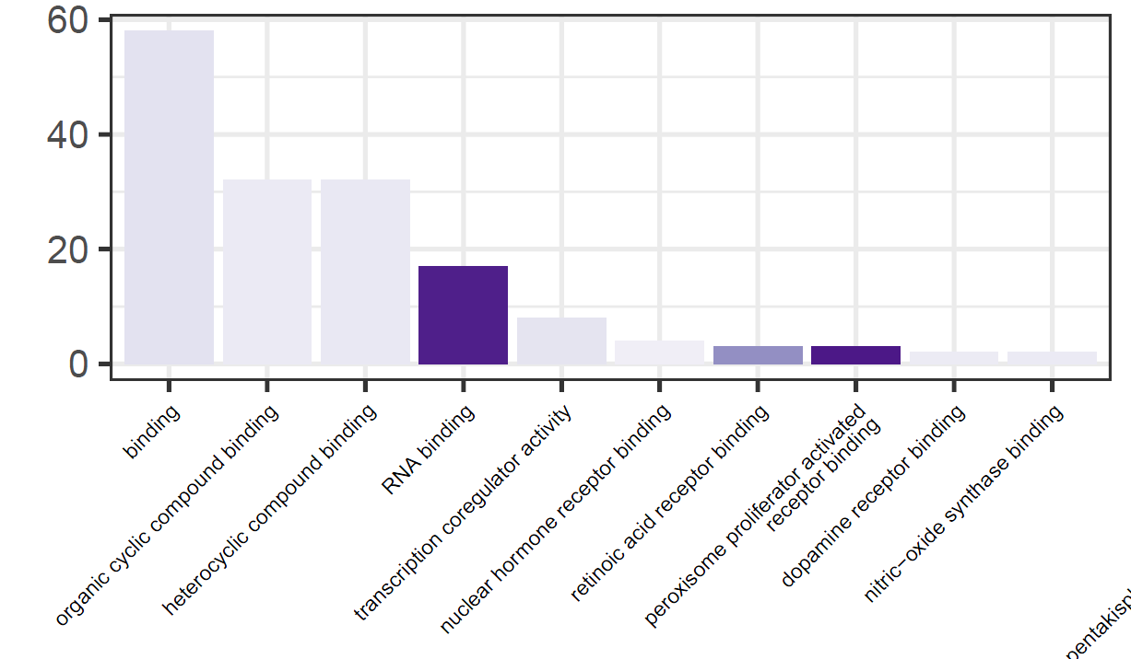
Cluster-wise GO terms of interest – JUM (plausible only)
MF
MBNL1, SRRM2, SRPK2, PARK7, UBE2O, DDX39A, DZIP3, FMR1, TNRC6A, UBAP2L, FNDC3A, ZC3H11A, RPLP0, RPL17, EIF4H, THOC5
ASXL1 (polycomb), NCOA7, NCOR2, PRMT2, SRSF2, KDM3A, COPS5, UBP1, MIER1, KCTD1(Wnt), HMGA1 (insulin), ZBTB7A
BP
MF
SRSF2, SRSF6, MBNL1, HNRNPH1, CLK4, PPIG, SMNDC1, MAGOHB, FASTK

Slide 19
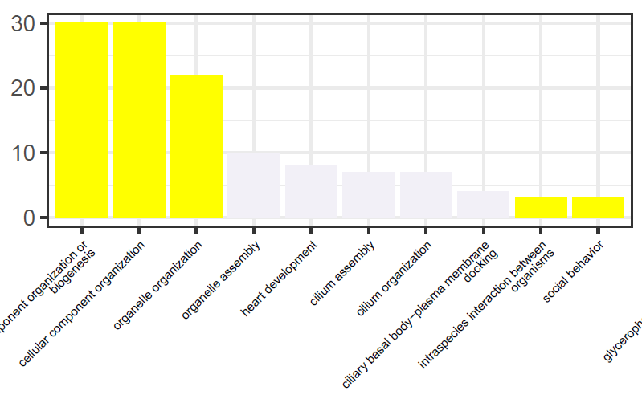
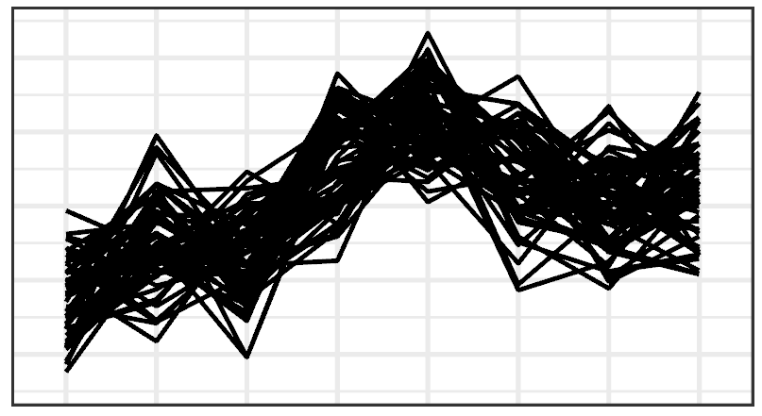
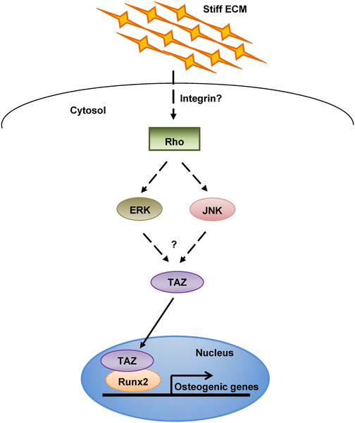
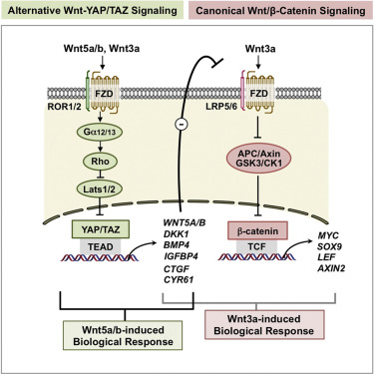
Cluster-wise GO terms of interest - PSI-Sigma
BP
YAP1, TAZ, TPM1, GALNT11, ANK2, LTBP1, ARL13B, ADAM15
Park, H.W., Kim, Y.C., Yu, B., Moroishi, T., Mo, J.S., Plouffe, S.W., Meng, Z., Lin, K.C., Yu, F.X., Alexander, C.M. and Wang, C.Y., 2015. Alternative Wnt signaling activates YAP/TAZ. Cell, 162(4), pp.780-794.
Hippo pathway mediates mechanosensitive differentiation mechanisms
Major crossroad of RUNX2 and Wnt cascades
Cilia-mediated mechanosensation is intimately related to YAP/TAZ system
Also in this cluster: SRSF11 (2 exons). Possible splicing-regulated splicing?
YAP1 is just shy of significance in JUM (q = 0.011, ΔPSI = 13.4%). TAZ ΔPSI = 15.9% but q-value high
Hwang, J.H., Byun, M.R., Kim, A.R., Kim, K.M., Cho, H.J., Lee, Y.H., Kim, J., Jeong, M.G., Hwang, E.S. and Hong, J.H., 2015. Extracellular matrix stiffness regulates osteogenic differentiation through MAPK activation. PloS one, 10(8).

Slide 20
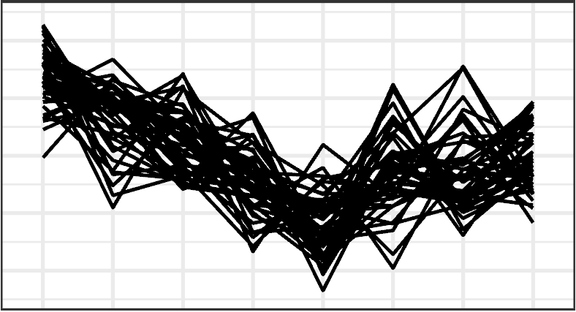
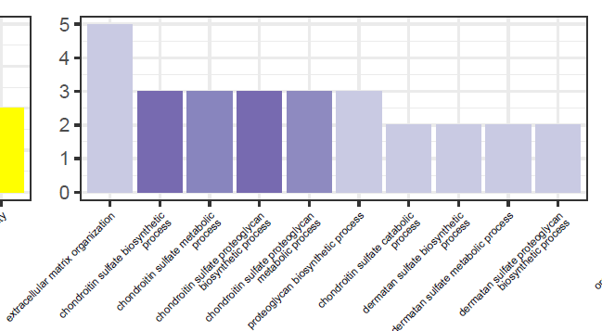
Cluster-wise GO terms of interest - PSI-Sigma
Corresponding cluster in JUM has ADAM15, CIC, GALNT11, SRSF11 in common
CFLAR ECM2 DCN VCAN ADAM15
BP

Slide 21
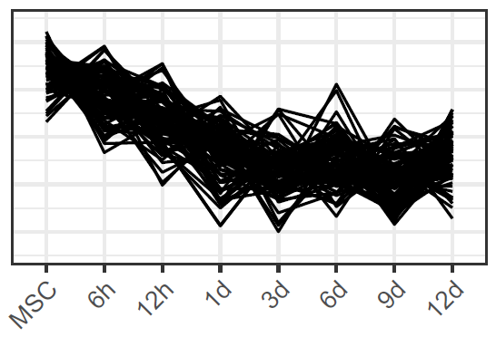
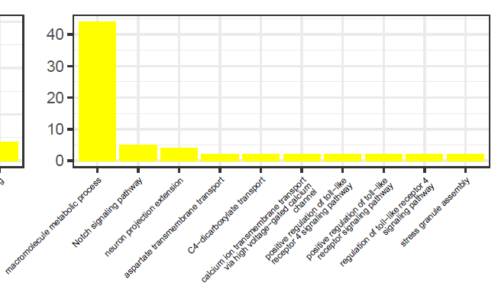
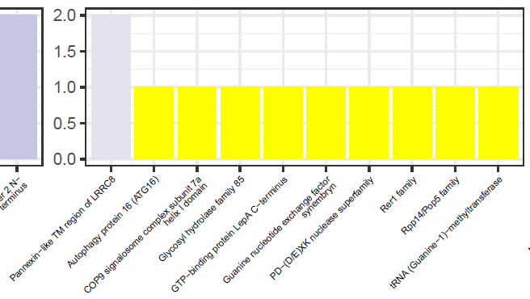
Cluster-wise enrichments of interest - PSI-Sigma
BP
CACNA1C, CACNB3
PFAM
LRRC8E, LRRC8D
CACNAs are calcium voltage-gated channel subunits
Known function in OBs for Ca²⁺ uptake
Other members of the CACNA family have appeared in JUM
LRRC8D/8E are volume−sensitive anion channels … AS modulates cell swelling of mature osteoblasts?

Slide 22
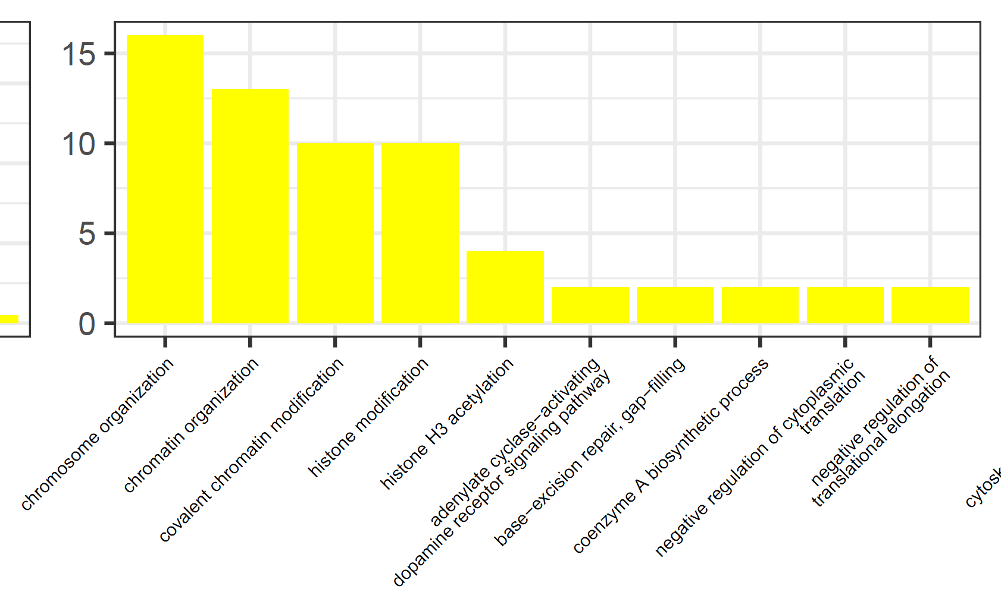
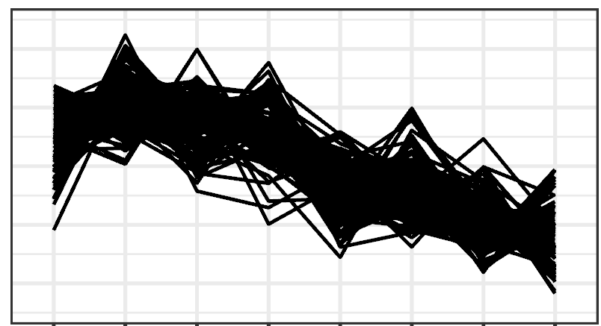
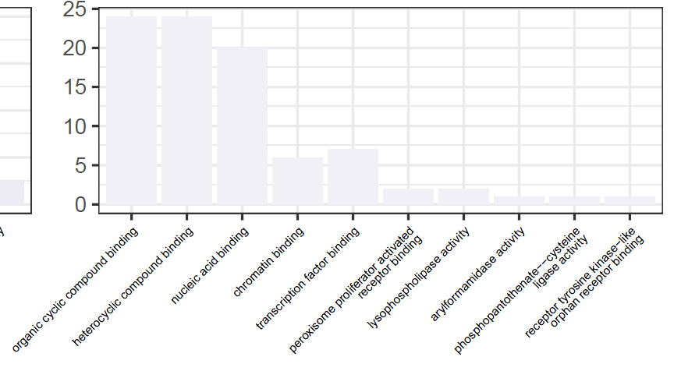
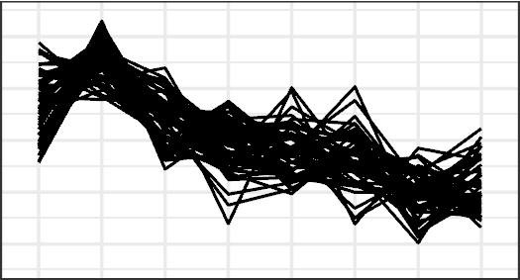
Cluster-wise GO terms of interest - PSI-Sigma
BP
SMARCB1, ARID2 … form the BAF (mammalian SWI/SNF) complex
BRPF1 positively regulates RUNX2
AS in DNA polymerases???
SMARCB1, BRPF1, ARID2, NAA60, UBR2, UBE2A, MTF2, PHC1, FMR1, SGF29, NTMT1
POLB, POLD1
Common (14): CLEC16A, NAA60, PPCS, SEC14L2, SMARCB1, SORBS3, TACC1
MF
SMARCB1, NUP98, NFATC4, ING2, PHF19, DDX5

Slide 23


Cluster-wise GO terms of interest - PSI-Sigma
BP
SMARCB1, ARID2 … form the BAF (mammalian SWI/SNF) complex
BRPF1 positively regulates RUNX2
AS in DNA polymerases???
SMARCB1, BRPF1, ARID2, NAA60, UBR2, UBE2A, MTF2, PHC1, FMR1, SGF29, NTMT1
POLB, POLD1
Common (14): SMARCB1, FBXL19, NFATC4, WNK1 (Wnt), NFE2L1 (OSX), MLST8 (mTORC), NAA60, NAV3, CPNE7, POLB, SEC14L2, SNHG29, SORBS3, SPEG
MF
SMARCB1, NFATC4, ATF2, ING2, RCC1, NCOR2, SMAD6, NFE2L1, PHF19, DDX5

Slide 24




Cluster-wise GO terms of interest - PSI-Sigma
PFAM
BP

Slide 25



Cluster-wise GO terms of interest - PSI-Sigma
BP
MF

Slide 26
Recurring genes of interest - JUM
SRSF11
(sub-junctions)
MACF1 (6)
MBNL1 (11)
SRRM2 (8)
WNK1(5)
SRSF2/6
MBNL2
SRSF6
SRSF6
Others :
ATP2B1/4/2C1
ATXN2L
SRSF11
SRSF3
SRSF11
SRSF11
ATXN2L
RUNX2

Slide 27
Recurring genes of interest – PSI-Sigma
MACF1
MBNL1/2
SRSF3/5/6/11
KDM1A/4A/4C/6A
RUNX2
Others :
PLEKHA1/B2/G2/G4/M2
PRMT2/3/7

Slide 28


A hierarchy of splicing factors?
Splicing factors (SFs) mediate splicing cascades
Specificity of splicing driven by SFs
Certain SFs promote exon inclusion (SR proteins), others promote skipping (HNRNPs)
Alternative splicing (or genomic mutations) in SFs may alter target specificity (example: P95H variant of SRSF2)
SFs may, themselves, be spliced by an upstream SF
Park, E., Pan, Z., Zhang, Z., Lin, L. and Xing, Y.I., 2018. The expanding landscape of alternative splicing variation in human populations. The American Journal of Human Genetics, 102(1), pp.11-26.

Slide 29
One splicer to rule them all?
Hypotheses:
There exist master splicing regulators within a splicing regulatory network
In a directed network: R = deg_{out}:deg_{in} (high), deg_{centrality} (high)
SFs have varying levels of “master-ness”, resulting in a complex cellular splicing landscape
Complexity is combinatorically generated. i.e. SFs which act as large sinks (low R, deg_{centrality} high) are more likely to have more isoforms
Conversely, highly spliced genes cannot be “master”
Park, E., Pan, Z., Zhang, Z., Lin, L. and Xing, Y.I., 2018. The expanding landscape of alternative splicing variation in human populations. The American Journal of Human Genetics, 102(1), pp.11-26.
M
A

Slide 30
One splicer to rule them all?
Hypotheses:
There exist master splicing regulators within a splicing regulatory network
In a directed network: R = deg_{out}:deg_{in} (high), deg_{centrality} (high)
SFs have varying levels of “master-ness”, resulting in a complex cellular splicing landscape
Complexity is combinatorically generated. i.e. SFs which act as large sinks (low R, deg_{centrality} high) are more likely to have more isoforms
Conversely, highly spliced genes cannot be “master”
Park, E., Pan, Z., Zhang, Z., Lin, L. and Xing, Y.I., 2018. The expanding landscape of alternative splicing variation in human populations. The American Journal of Human Genetics, 102(1), pp.11-26.
M
A
A1
A2
A3
A4
…
M1
M2

Slide 31

Functional enrichment (timepoint-wise)
GO Terms and PFAM families for ALL genes containing differential junctions/exons
For clustered junctions/exons, functional enrichment done:
ClueGO Terms (each cluster)
PFAM families (each cluster)
Upstream RNA-binding proteins (from CLiP-Seq, FLASH-Seq)

Slide 32









Functional enrichment (BP GO) (highest per time point) PSI-Sigma
MSC
12h
6h
1d
3d
6d
9d
12d

Slide 33








Functional enrichment (BP GO) (highest per time point) JUM
MSC
12h
6h
1d
3d
6d
9d
12d

Slide 34
Summary
Functional enrichment yielded:
Things related to Wnt and Hippo signalling
OB phenotype targets (lysosome, ion channels)
Splicing regulators, TFs, chromatin remodellers
Cytoskeletal, ECM components (a lot)
Some similarity between JUM and PSI-Sigma temporal profiles
High splicing of splicing factors
Park, E., Pan, Z., Zhang, Z., Lin, L. and Xing, Y.I., 2018. The expanding landscape of alternative splicing variation in human populations. The American Journal of Human Genetics, 102(1), pp.11-26.
M
A
A1
A2
A3
A4
…
M1
M2

Slide 35

Spliceome dynamics during osteogenesis
Part IIb: Consequences of alternative splicing at the exon/junction level (RNA-Seq)
Angel Liang
7/4/2020

Slide 36

Junction/Exon ontology
Gene ontology alone is not sufficient
Transcript-level changes
Alteration of mRNA stability (5/3’ UTR)
Nonsense-mediated decay (NMD)
Protein domain changes
Tuning of PPIs by interaction domain truncation
Alteration of PTM residues
JUM: differential regions were calculated from contributing junctions of each Local Splice Variant (see right).
A vastly superior analysis strategy that allows composite events to be interrogated in detail; resistant to long introns.
PSI-Sigma: differential exons used as differential regions

Slide 37
Junction/Exon ontology
Gene ontology alone is not sufficient
Transcript-level changes
Alteration of mRNA stability (5/3’ UTR)
Nonsense-mediated decay (NMD)
Protein domain changes
Tuning of PPIs by interaction domain truncation
Alteration of PTM residues
JUM: differential regions were calculated from contributing junctions of each Local Splice Variant (see right).
A vastly superior analysis strategy that allows composite events to be interrogated in detail; resistant to long introns.
PSI-Sigma: differential exons used as differential regions
Index all reference transcripts with junction-flanking exon pairs

Slide 38
Junction/Exon ontology
Gene ontology alone is not sufficient
Transcript-level changes
Alteration of mRNA stability (5/3’ UTR)
Nonsense-mediated decay (NMD)
Protein domain changes
Tuning of PPIs by interaction domain truncation
Alteration of PTM residues
JUM: differential regions were calculated from contributing junctions of each Local Splice Variant (see right).
A vastly superior analysis strategy that allows composite events to be interrogated in detail; resistant to long introns.
PSI-Sigma: differential exons used as differential regions
For the left and right ends, only regions that appear ONCE and do not overlap are considered differential

Slide 39
Junction/Exon ontology
Gene ontology alone is not sufficient
Transcript-level changes
Alteration of mRNA stability (5/3’ UTR)
Nonsense-mediated decay (NMD)
Protein domain changes
Tuning of PPIs by interaction domain truncation
Alteration of PTM residues
JUM: differential regions were calculated from contributing junctions of each Local Splice Variant (see right).
A vastly superior analysis strategy that allows composite events to be interrogated in detail; resistant to long introns.
PSI-Sigma: differential exons used as differential regions
For the left and right ends, only regions that appear ONCE and do not overlap are considered differential

Slide 40
Transcript-level features

Slide 41
Transcript-level features

Slide 42

InterPro domains (JUM)

Slide 43

InterPro domains (PSI-Sigma)

Slide 44

Frame-altering events? (JUM)

Slide 45

NMD analysis
Nonsense mediated decay is a cellular quality control mechanism to degrade transcripts with Premature Termination Codons (PTCs)
AS can:
Result in downstream frameshift, generating in-frame PTC
Alter PSI of exons harbouring an in-frame PTC (poison exons)
Literature reports on the conservation/regulation of poison exons seems to be valued
Our reporting:
Prediction of NMD candidates (based on assembled transcriptome)
Matching junctions/exons to NMD transcripts (by identifying NMD-transcript-specific exons/junctions)
Downstream analyses…
IN THIS STUDY: a complement of “cancer-essential exons” was identified using a modified CRISPR protocol to knock-out specific exons in HeLa

Slide 46



Predicting NMD candidates (de novo)
The last exon-exon junction is important
51nt is thought to be the golden number (Hsu. et. al., 2017)
Their program didn’t work (seems to only take Cufflinks input). Therefore create my own.

Slide 47
Predicting NMD candidates (de novo)
Have assembled transcriptome from Strawberry (Liu & Dickerson, PLoS comp. bio., 2017)
Method:
For each assembled transcript, do three-frame translation
Consider 51 nt window before the last exon-exon junction
If there is a stop codon in the window in ALL frames, then it’s an NMD candidate
Junctions/exons were matched to each transcript
Those which only matched to NMD transcripts are flagged as NMD junctions/exons.
The same condition for NMD junctions/exons was applied after matching against the reference annotation (Ensembl 38 v98)
The union of both sets of candidates were taken

Slide 48
Apparent poor agreement with reference NMD
Exons
Initial run with PSI-Sigma
Very poor agreement with the “nonsense_mediated_decay” (transcript_biotype) annotation in Ensembl 38 v98
Is the 51nt rule incorrect?
What do the other flagged transcripts match to then, if not “nonsense_mediated_decay”?
Ensembl
3289
239
J = 4.11%
PSI-Sigma
2290

Slide 49

Apparent poor agreement with reference NMD?
NMD flagger was used to re-detect NMD transcripts from the Ensembl 38 v98 reference annotation
The vast majority of flagged transcripts were found to be non-coding!
It’s known that retained intron transcripts are often NMD and/or non-coding
Some lncRNAs are subject to ribosome engagement – hence regulation of expression by NMD (Smith, J.E. and Baker, K.E., 2015. Nonsense‐mediated RNA decay–a switch and dial for regulating gene expression. Bioessays, 37(6), pp.612-623.)
The percentage of transcripts associated with NMD could be (much) greater than previously thought (Lewis, B.P., Green, R.E. and Brenner, S.E., 2003. Evidence for the widespread coupling of alternative splicing and nonsense-mediated mRNA decay in humans. Proceedings of the National Academy of Sciences, 100(1), pp.189-192.)
In that study, “one-third of the alternative transcripts examined contain premature termination codons, and most persist even after rigorous filtering by multiple methods”

Slide 50
Apparent poor agreement with reference NMD?
All reference transcripts
Flagged as NMD
Not flagged
Actually not subject to NMD
Subject to NMD but doesn’t obey 51nt rule
Actually NMD
Not a real NMD target e.g. protein coding
Subset: annotated NMD
Some known protein-coding transcripts were flagged
This represents the minimum false positive rate
Accordingly, the false negative rate of the NMD flagger is very high
Supplementation of the reference annotation with a conservative implementation of NMD flagger is statistically sound
False positive
True negative
False negative
True positive

Slide 51
Why were protein coding transcripts flagged?
Additionally, the initial run considered all transcripts with at least 2 exons
It was found that many flagged transcripts were 2-exons long
The exon length cutoff could explain the presence of protein-coding transcripts being flagged as NMD
Flagging of the Ensembl reference repeated for exon length cut-offs of 2 thru to 5
Results:
Greater proportions of protein-coding transcripts were removed with increasingly stringent cutoff
The Jaccard similarity reached a maximum at a cut-off of 4
Jaccard similarity is not a direct indicator of performance but could be a relative measure (assuming A⋂B:A is the same for ALL REAL NMD)

Slide 52





Slide 53
Summary
Disagreement with reference annotation does NOT mean the NMD flagger is wrong
NMD flagger identified mostly non-coding transcripts, an informative discovery
Disagreement is driven by two things:
High false negative rate of NMD flagger
The Ensembl annotation is almost certainly incomplete
Protein-coding genes with 2/3 exons per transcript greatly confound the NMD flagger; this is somewhat alleviated by a more stringent cutoff.
Many transcripts are known to escape NMD
Therefore use a minimum of 4 exons/transcript for analysis as a compromise

Slide 54


NMD reporting* - PSI-Sigma
*For reference, the percent of transcripts which were annotated as NMD in the Ensembl reference ≈ 7%
There are 10.46% NMD exons overall.
There are 18.83% first exons overall.
There are 21.76% last exons overall.
There are 13.02% NMD exons constitutive.
There are 12.98% first exons constitutive.
There are 11.49% last exons constitutive.
There are 7.85% NMD exons differential.
There are 20.87% first exons differential.
There are 19.77% last exons differential.

Slide 55

UpSet plot – differential exons (PSI-Sigma)
top causes of NMD
most likely locations of exons and NMD
*For reference, the percent of transcripts which were annotated as NMD in the Ensembl reference ≈ 7%

Slide 56



NMD reporting* - JUM
*For reference, the percent of transcripts which were annotated as NMD in the Ensembl reference ≈ 7%
There are 11.01% NMD junctions overall.
There are 54.95% first junctions overall.
There are 53.28% last junctions overall.
There are 9.73% NMD junctions constitutive.
There are 51.08% first junctions constitutive.
There are 52.54% last junctions constitutive.
There are 14.22% NMD exons differential.
There are 70.15% first exons differential.
There are 58.00% last exons differential.
There are 12.70% NMD exons differential (plausible).
There are 60.32% first exons differential (plausible).
There are 53.49% last exons differential (plausible).

Slide 57

UpSet plot – differential junctions (JUM)
top causes of NMD
most likely locations of junctions and NMD
*For reference, the percent of transcripts which were annotated as NMD in the Ensembl reference ≈ 7%

Slide 58
First/Last exon concordance per entry (reference vs. Strawberry, JUM junctions)
First exon
Last exon
8710
13479
J = 0.55
60.7%
85.9%
2220
10750
9928
J = 0.43
48.0%
80.4%
2424

Slide 59

Published benchmark for Strawberry
Liu, R. and Dickerson, J., 2017. Strawberry: Fast and accurate genome-guided transcript reconstruction and quantification from RNA-Seq. PLoS computational biology, 13(11), p.e1005851.

Slide 60
First/Last exon concordance per LSV (reference vs. Strawberry, PSI-Sigma exons)
First exon
Last exon
146628
20475
J = 0.11
12.3%
44.8%
25244
143655
35940
J = 0.18
20.0%
64.5%
19823

Slide 61


First/Last exon concordance (reference vs. Strawberry)
PSI-Sigma exons were less concordant with reference compared to JUM junction-associated exons
Possible explanation: each junction is associated with two exons – overall greater chance to catch an annotated exon
Calls to first exons are the most common discrepancies in the assembled transcriptome
Possibly reflects non-uniform junction read coverage (greater at the 3’ end)?
Exon read coverage did not seem to vary along transcript

Slide 62
NMD Summary
Distinct locations of differential splicing and NMD-specific features observed
Poor agreement of first/last exon annotation between assembled and reference transcriptome
Will be dropping the assembled first/last exon in the final analysis
Discrepancies in NMD annotation is expected to mostly result from missing 3’ regions in the assembled transcriptome
Missing 5’ regions are more prevalent than missing 3’ regions in the assembled transcriptome, possible artifact from poly(A) capture

